Slide 1
How to setup Game Object and vertical movement alone with camera movement in Unity
By- Kundan Kumar Verma
Reg. Id- 20MCA10037
Tutorial link -> https://youtu.be/U3sT-T5bKX4

Slide 2
Creating an object
Go to Asset, right click and create game object name it player
Go to Inspector, set player’s following properties to
Scale X, Y and Z axis to 0.5, 0.5 and 1 respectively.
Now change the gravity scale to 0.
Freeze Z Rotation under constraints
Create the C# script and add the following code

Slide 3
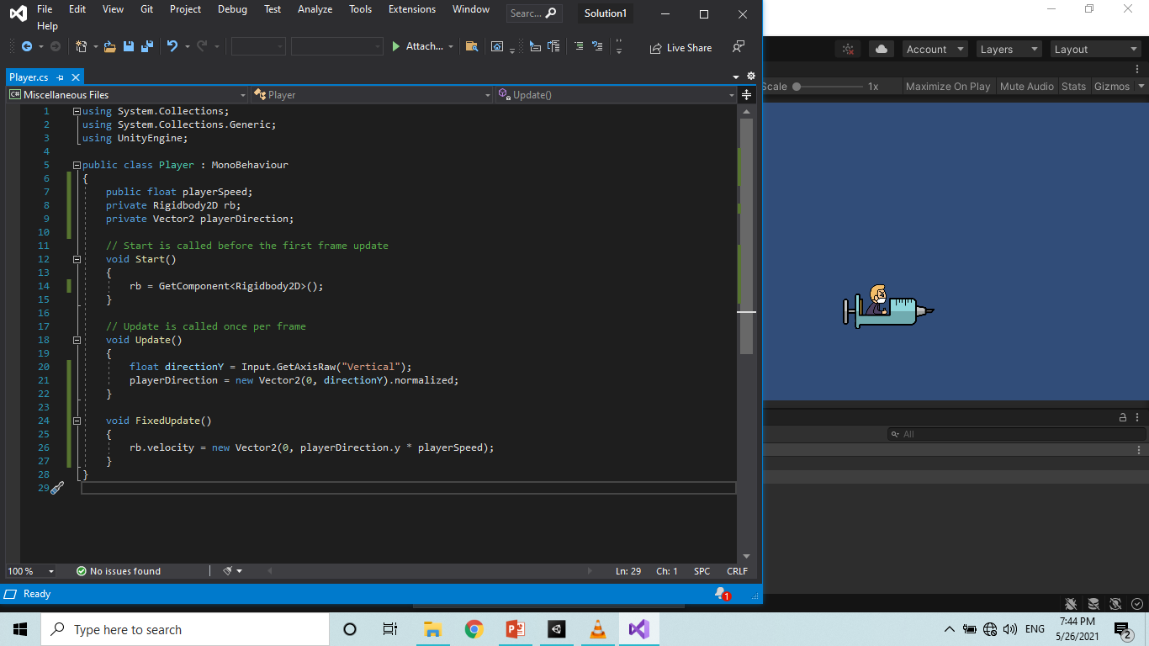

Slide 4
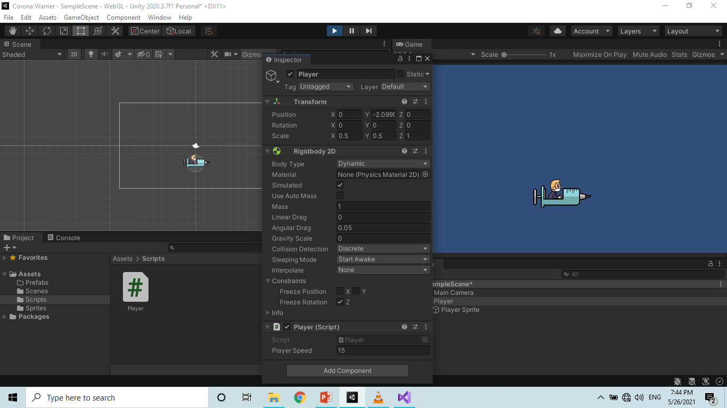

Slide 5
Adding Vertical movement to Game Object
Now add the script to Player Game Object.
Set the Player Speed under script section of inspector window.
Now run the game.
Use down and up arrow key for game object movement.

Slide 6
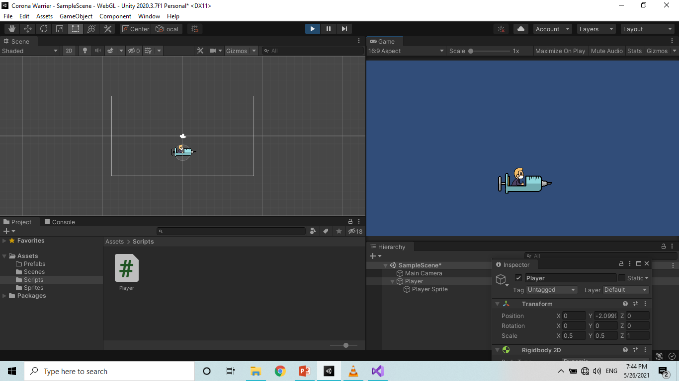

Slide 7
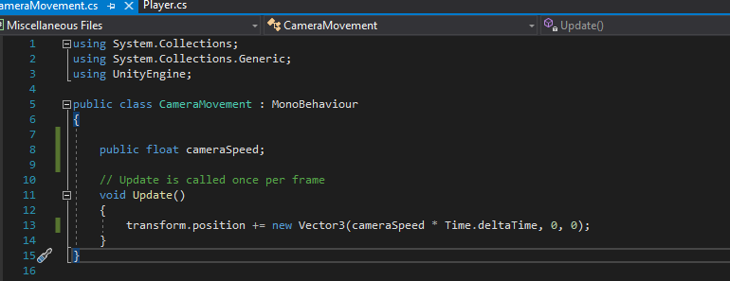
Setting up camera movement
Create new C# script file
Write down the code.
Now, Create new game object
say Main Camera
Right click -> select empty object
-> name it as Game Object
Drag Main Camera and Player object under Game Manager
Set the speed of camera to 15.

Slide 8
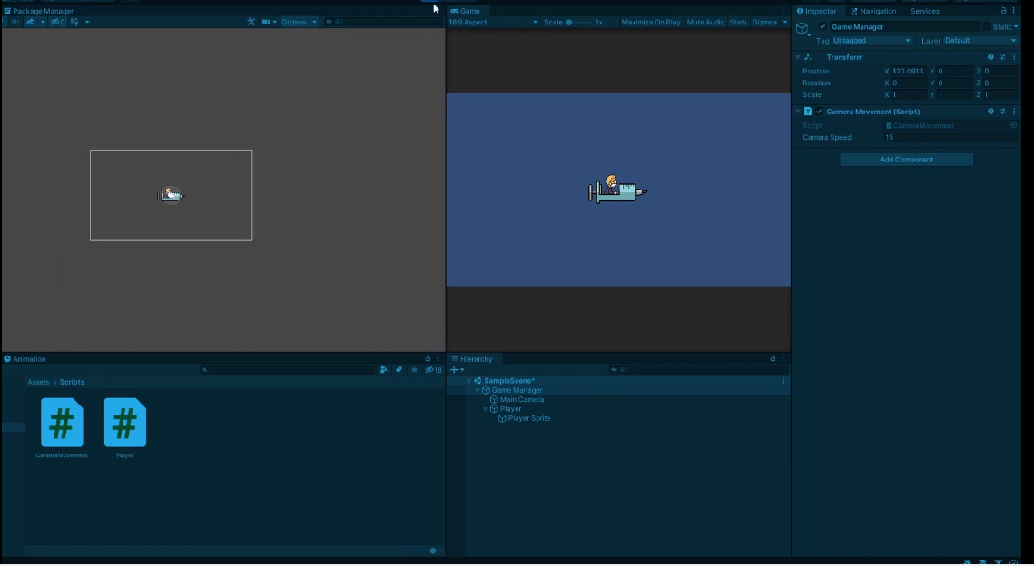

Slide 9
Thank You

